Slide 1

Capstone Project
Pakistan retail/ecommerce data analysis & future sales prediction
Vivek Dumbre

Slide 2
Content
● Problem Statement
● Approach
● Data Summary
● Exploratory Data Analysis
● RFM analysis
● Model building:
● Model Performance and Evaluation
● Conclusion and Recommendations
● Reference slide

Slide 3
Problem Statement
The largest retail e-commerce orders dataset from Pakistan. It contains half a million transaction records from March 2016 to August 2018. The data was collected from various e-commerce merchants as part of a research study. The major problems to solve or to analyze are as mentioned below -
What is the best-selling category?
Visualize payment method and order status frequency
Find a correlation between payment method and order status
Find any hidden patterns that are counter - intuitive for a layman
Can we predict number of orders, or item category or number of customers/amount in advance?

Slide 4

Approach
The following approach was followed in the completion of the project:
Data Collection & Load
Data Collection and Preprocessing
Data Cleaning
Missing Data Handling
Merging the Datasets
Exploratory Data Analysis
- Hypotheses
- Categorical Features
- Continuous Features
- EDA Conclusion and Validating Hypotheses
Data Modelling and Manipulation
- Feature Engineering
- Outlier Detection and Treatment
RFM Analysis by visualizing data
- Elbow curve and Silhouette analysis to determine No. segments
- Segmentation
Modelling
-Train -Test split
- Comparing the model fitment
- Feature Scaling
- Categorical Data Encoding
Model Performance Evaluation and Selection
- Visualizing Models
- Testing Model performance
Finding Hidden Trends
- Visualizing Data for finding various hidden patterns and trends based on seasonal behaviours
Conclusive Insight Recommendations.

Slide 5
Data Collection &
Load.
The dataset contains variables as follows with the following summary details.
- item_id
- status
- created_at
- sku
- price
- qty_ordered
- grand_total
- increment_id
- category_name_1
- sales_commission_code
- discount_amount
- payment_method
- Working Date
- BI Status
- MV
- Year
- Month
- Customer Since
- M-Y
- FY
- Customer ID
- Unnamed: 21
- Unnamed: 22
- Unnamed: 23
- Unnamed: 24
- Unnamed: 25
Dataset Dimensions : (1048575, 26)
The Data set is a huge collection of orders placed by customers from various ecommerce businesses describing various demographic and natural behaviours in the orders of pakistan.
the data collected includes orders from 2016 to 2018.

Slide 6

Data Cleaning & Preprocessing
Although the
data acquired is ample
in amount and describes
a lot of information but after
cleansing the dataset shrinks down
to only 50% of valid records post handling missing values.

Slide 7

E D A
EDA is probably the most important step in any kind of Data analytics case study as it lays down the basis and direction of the analysis towards proper modelling.
Thus we must avoid completely getting rid of any record and should emphasize on mean, median or mode replacement in the missing value cells.
Moving to our data to achieve the objectives mentioned earlier in the Problem statement we will be carefully handling the data and make necessary adjustments.
Let’s move forward to the technical analysis and the code of the study.

Slide 8
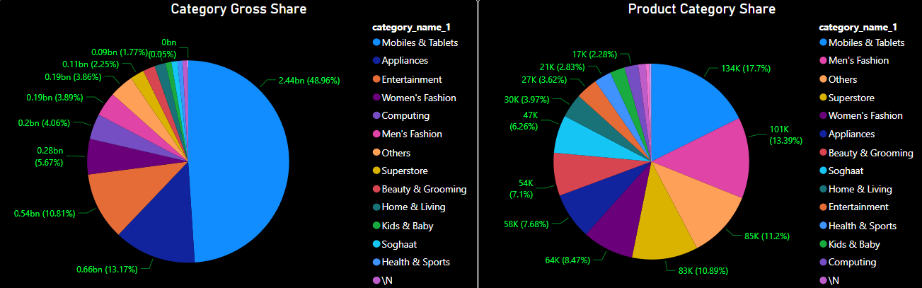
What is the best-selling category?
The categorical sales is clearly dominated by “Mobiles $ Tablets” in both segments i.e. in Gross sales and number of products sold per category as shown below in the designed pie plot designated for all categories sales.

Slide 9
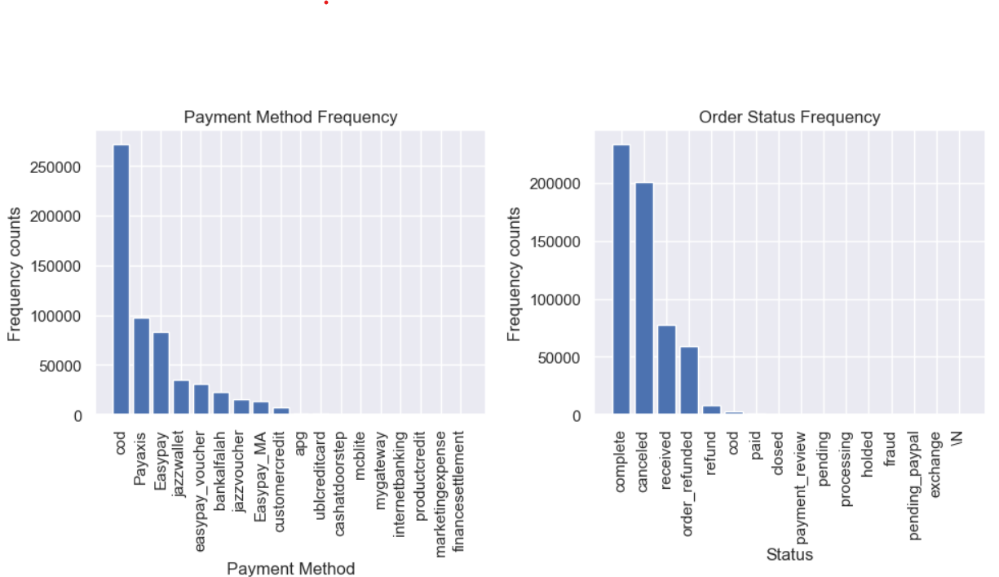
Visualize payment method and order status frequency

Slide 10
Find a correlation between payment method and order status
As we already know payment method and Offer Status are both categorical variables to find the correlation between them we need the Chi- Square Test to map their inter-dependence as the variables are non numeric.
The chi-square : 208092.8816361259, p-value : 0.0
The chi-square statistic indicates the strength of association between the two categorical variables. A higher chi-square value suggests a stronger association.
The p-value is a measure of the statistical significance of the association. In this case, the p-value is very close to zero (0.0), which suggests that the association between the variables is statistically significant. In other words, it is highly unlikely to observe such an association by chance alone.
These results indicate that there is a significant association or dependency between the two categorical variables you analyzed.

Slide 11
RFM Analysis & Segmentation
RFM analysis is a marketing technique used to quantitatively rank and group customers based on the recency, frequency and monetary total of their recent transactions to identify the best customers and perform targeted marketing campaigns.

Slide 12
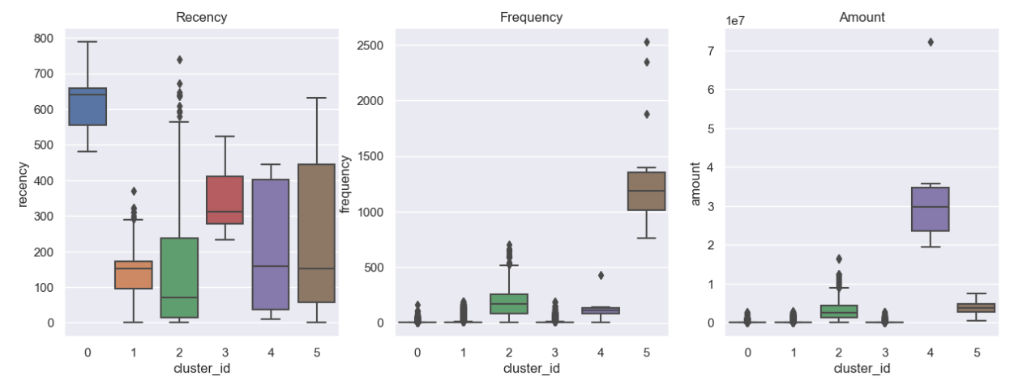
RFM results

Slide 13
Model Building
In our problem we will be using the ARIMA and SARIMAx models for testing our hypothesis and build our models
The ARIMA model is great, but to include seasonality and exogenous variables in the model can be extremely powerful. Since the ARIMA model assumes that the time series is stationary, we need to use a different model.
Above is the the of the SARIMAX model. This model takes into account exogenous variables, or in other words, use external data in our forecast.

Slide 14
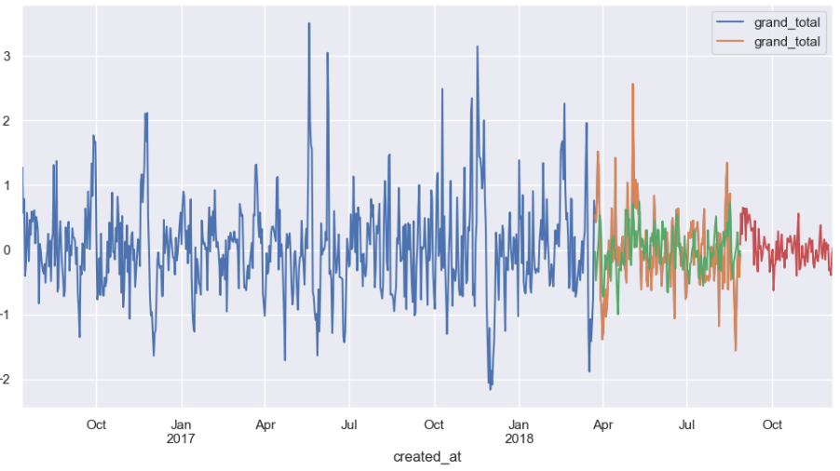
Red line shows predictions
Green Line shows training part of Dataset
Orange Line shows Test part of Dataset
Mean_absolute_error 0.4340195628655157
0.57113410026802
ARIMA model results

Slide 15
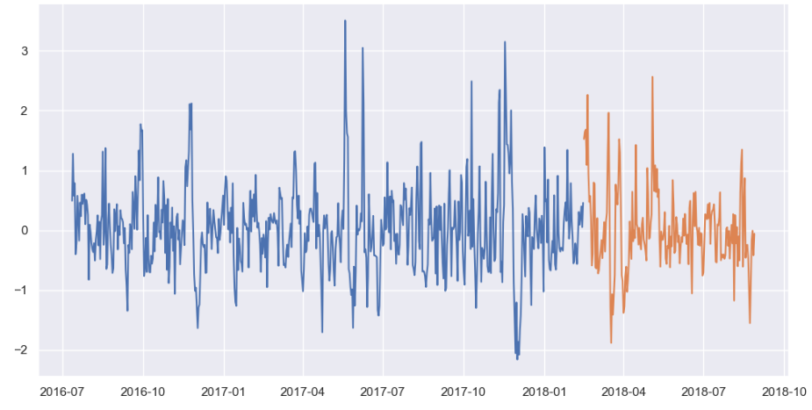
Naturally the SARIMAX model performs slightly better than the ARIMA model as it is more advanced in capturing features and making predictions due to its ability to take account of the seasonality and other external factors that might affect the analyis.
SARIMAX model results

Slide 16
Insights and Hidden trends found in data based on above analysis
We observe overall trend from july-2016 to aug-2018 and concluded following points
Purchases increases in last Three months ( October,November and December ) of 2016 and 2017
Most e-commerce buyers purchases products in November
November is most suitable month for sellers to market their products
Overall volume of ecommerce sales is increasing year by year
For example,you can compare first six months of 2017 with 2018

Slide 17

Thanks!
References:
Time-series forecasting
https://neptune.ai/blog/arima-sarima-real-world-time-series-forecasting-guide

